Slide 1
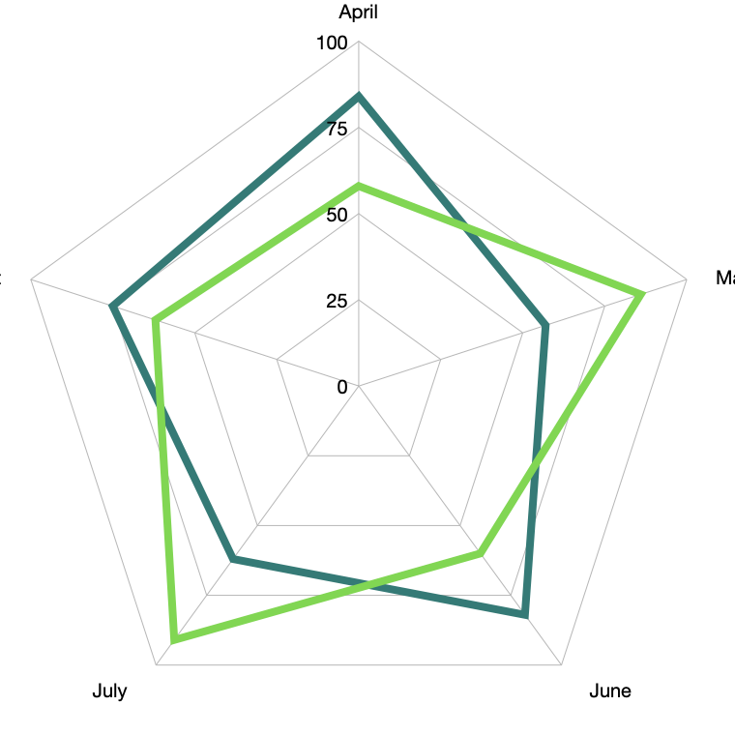
Resource Project Planning Systems
Zeroth Review Report
Prepared By: Akansha Rana
Presented Date: 28/Mar/2026
Prested To: Murli S vit

Slide 2
Project Contents
1. Problem Identification & Relevance​ Problem Statement​
Relevance to Industry and Specialisation​
2. Objectives & Scope​ Objectives​ Scope of the Study​ In scope Out of the scope
Architure Diagram
Flow Diagram
Process Diagram
3. Methodology / Approach​
Data Collection​ Data Preprocessing​ Data Analysis​ Model Development​ Visualisation & Dashboard​ Evaluation Metric

Slide 3
Problem Identification & Relevance
Problem:
In many IT service organizations, a significant number of employees remain on bench, meaning they are employed but not currently assigned to any active project. This situation creates challenges for organizations in terms of resource utilization, workforce planning, and productivity management.
Identifying employees with the right skills for upcoming projects
Identifying the project for upgrading skillset and practical knowledge for employe performance evaluation.
Monitoring the duration and trend of bench time
Understanding the skill gaps between employee capabilities and project requirements
Efficiently allocating available human resources to projects
The absence of a data-driven system for resource allocation and bench management leads to inefficient utilization of talent and increased. operational costs.
Therefore, this project proposes the development of a Data Science–based Bench Employee Utilization and Project Matching Tool that analyzes employee skill data, project requirements, and utilization trends to support better decision-making.

Slide 4
Relevance to Industry and Specialisation
This project is highly relevant to the fields of Data Science, Business Analytics, and Human Resource Analytics. Modern organizations are increasingly relying on data-driven decision-making to optimize workforce utilization and. improve productivity.
Analyze employee skill datasets
Identify patterns in workforce utilization
Recommend suitable employees for projects
Suggest upskilling opportunities for bench employees
Such a system can significantly support Project Leads, Project Managers, HR Departments, And Resource Management Teams in improving operational efficiency.​

Slide 5
Objectives & Scope
The primary objectives of this project are:
To analyse employee skill data and project requirements to understand workforce utilisation patterns within an organisation.
To identify bench employees and measure bench duration using data analytics techniques.
To develop a recommendation system that matches employees with suitable projects based on their skills and experience.
To perform skill gap analysis between available employee capabilities and project demand.
To create a dashboard for workforce analytics that provides insights into employee utilisation, skill distribution, and project allocation.

Slide 6
The scope of this project includes:
In Scope Activity
Analysing Employee who is on
Bench
PIP
Student
Not Employeed
Developing analytical models for resource allocation
Creating visualisation dashboards for project and project insights Implementing a simple recommendation system for employee–project matching. On daily, weekly, monthly, yearly basis.
It's a idea reccomandation system.
it provides a prototype model demonstrating how data science can support strategic decision-making in resource planning.
Out Of Scope Activity
The project focuses on data-driven workforce analytics and does not cover the full implementation of enterprise-level resource management systems.
It's datascience practise driven tool where it project project ideas as others tools avilable in market like leetcode, hackerrank etc.

Slide 7
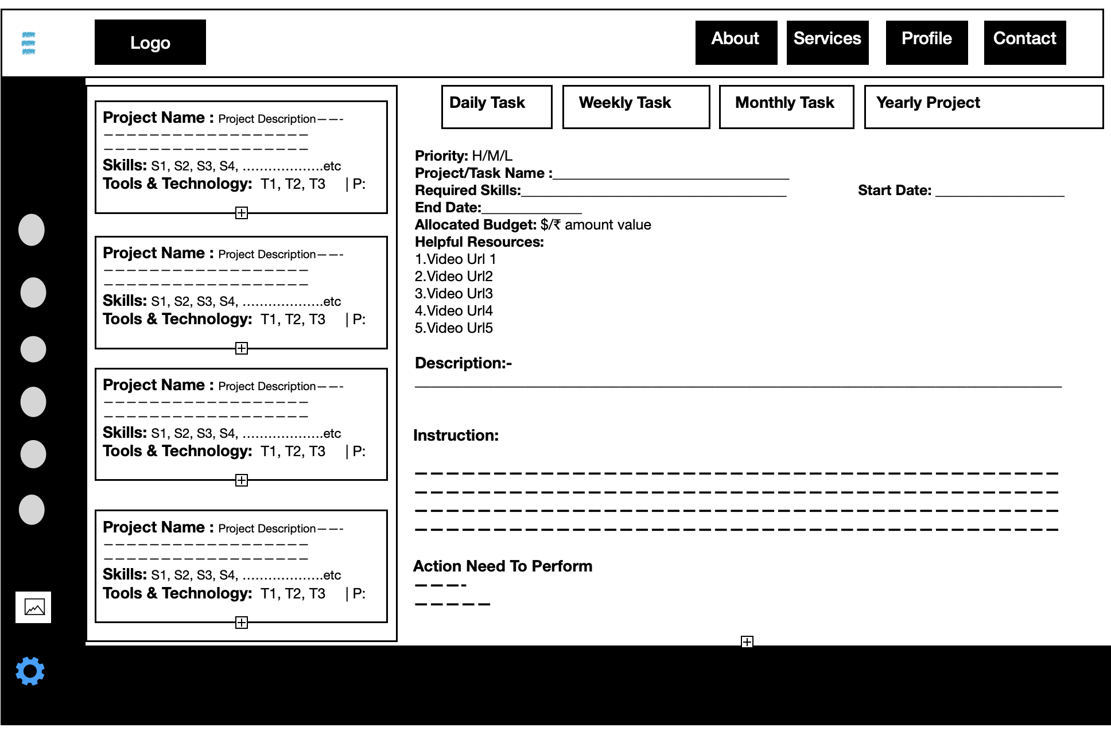
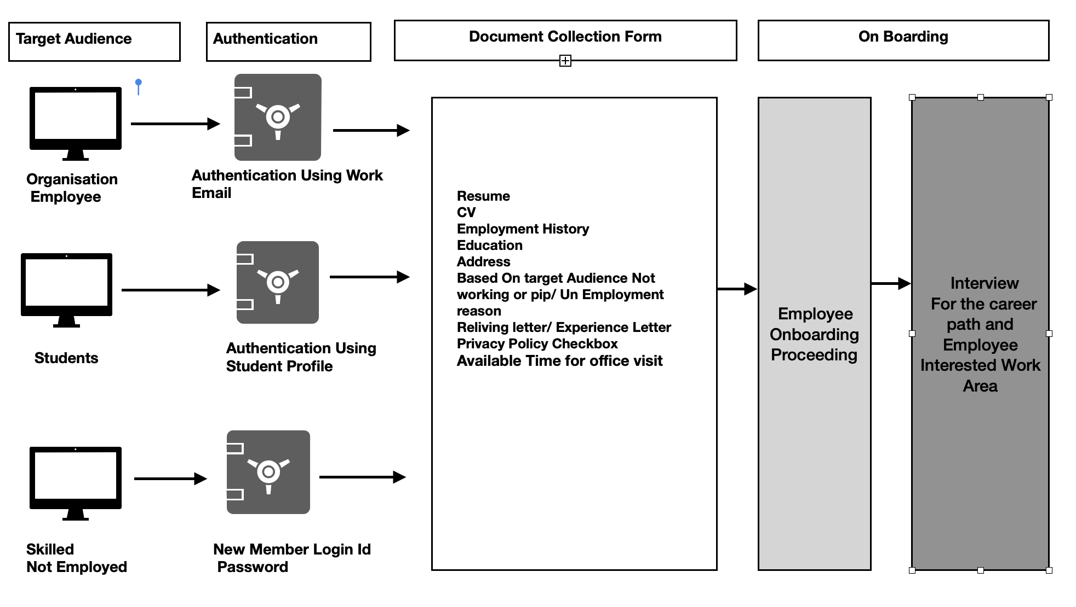
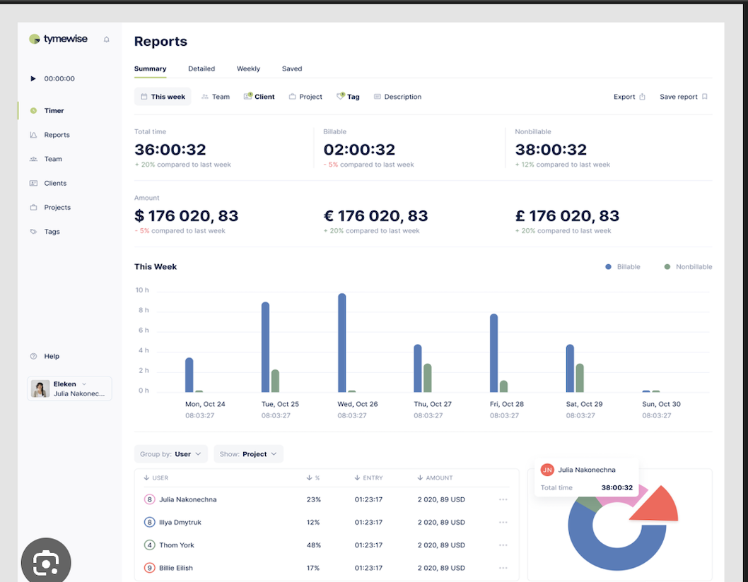
Architure Diagram
Step: 2
Step: 1
Step: 3

Slide 8
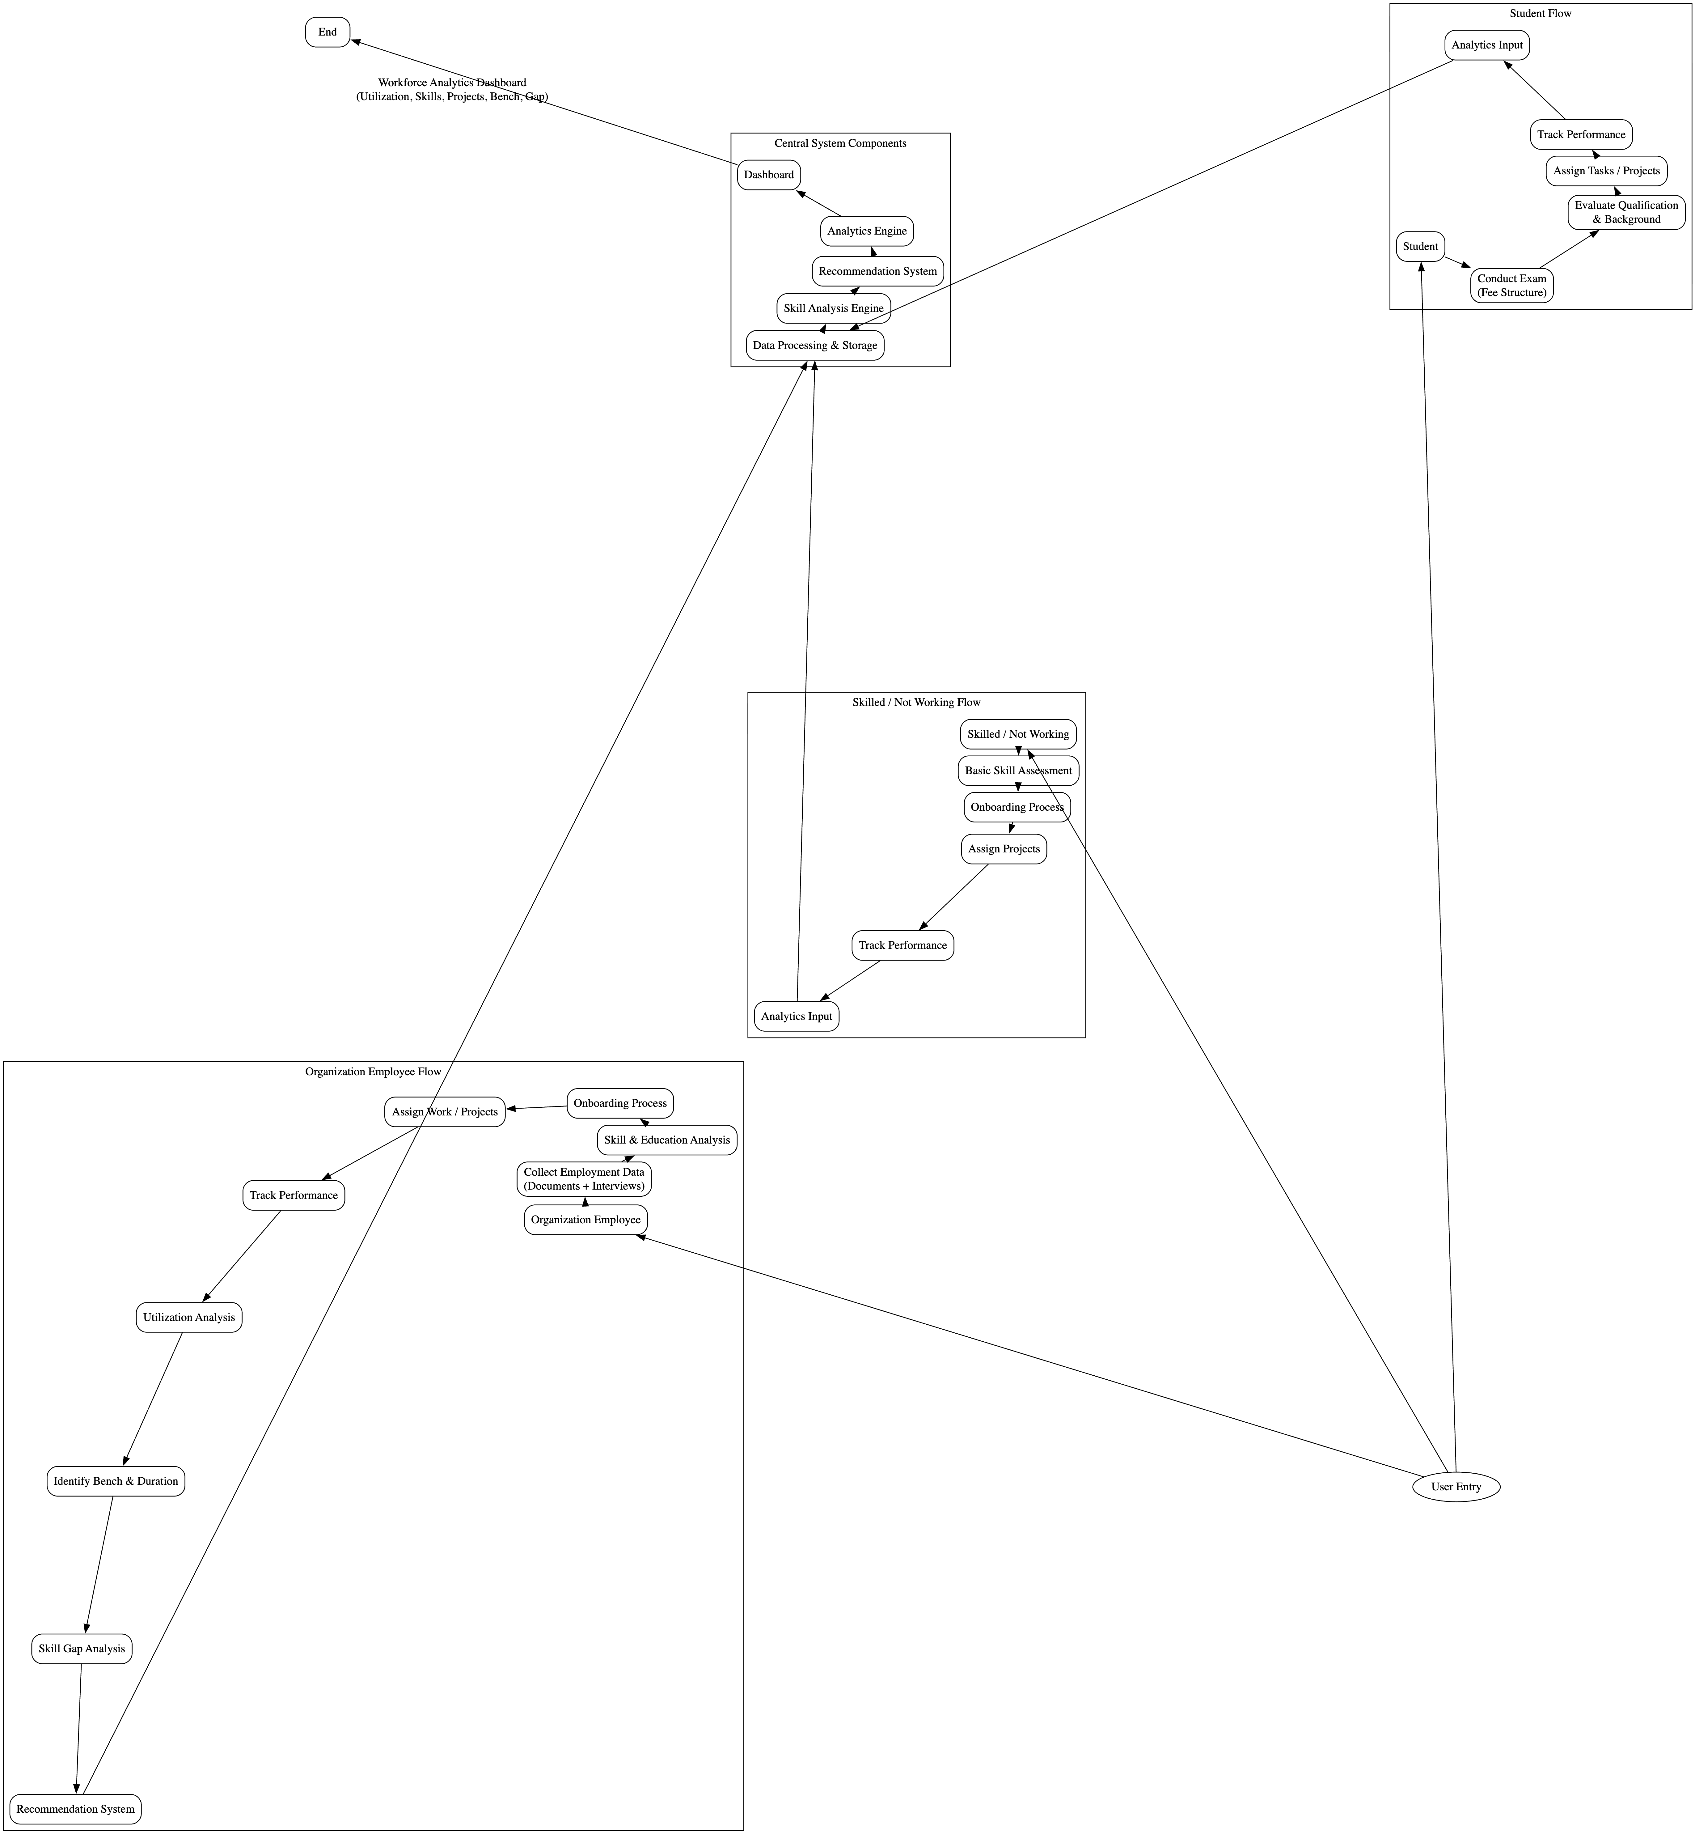
Flow Diagram

Slide 9
Methodology / Approach
Data Collection
Handling Null Values
Removing Outlier values
2. Data Preprocessing
3. Model Development
4. Cosine Similarity
5. KNN, RFM Algorithm
6. Predictive analytics to identify future resource needsVisualization & Dashboard
Bench employee statistics
Skill gap analysis
Project–employee match recommendations
Workforce utilisation metrics Evaluation
7. Descriptive Analytics
8. Financial Analytics

